Slide 1

Using Quantum to Calculate a Mixed-Strategy Nash Equilibrium in a Finite Two-player Game
Group: 10
Member: 蘇磐洋、張力元、林予康

Slide 2
Outline
What Is Game Theory?
What Is Nash Equilibrium?
Why Is It Important?
Quantum Game Theory
Quantum Gambling
Three Different Approaches
Classical Approach
Quantum Approach
Future

Slide 3
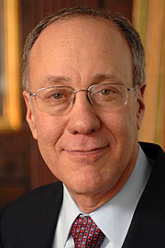
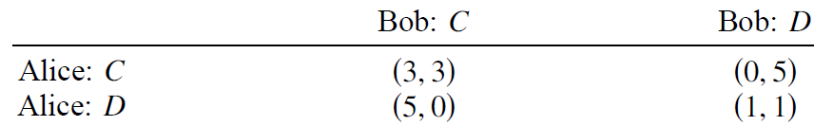
What Is Game Theory?
Roger Myerson
2007 Nobel Prize
The study of mathematical models of conflict and cooperation between intelligent rational decision-makers
Optimization Problem
R. B. Myerson, Game Theory: An Analysis of Conflict
Jens Eisert, Martin Wilkens, and Maciej Lewenstein, “Quantum Games and Quantum Strategies”

Slide 4
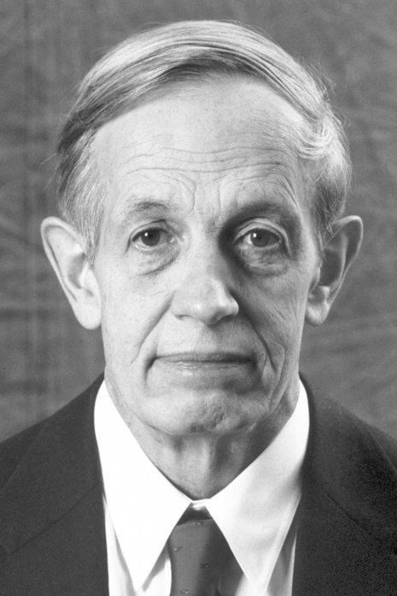
What Is Nash Equilibrium?
John F. Nash Jr.
1994 Nobel Prize
No one can be better off in a unilateral change in his or her decision
Central idea in game theory
Jens Eisert, Martin Wilkens, and Maciej Lewenstein, “Quantum Games and Quantum Strategies”

Slide 5
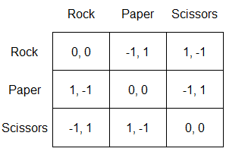
What Is Nash Equilibrium?
John F. Nash Jr.
1994 Nobel Prize
Every finite (two-player) game has a mixed-strategy Nash equilibrium
Not easy to calculate: exponential-time complexity
Not always a good solution
FNP, guaranteed to have a solution
FNP, e.g. Shor’s algorithm
https://mindyourdecisions.com/blog/2013/06/11/game-theory-in-bobs-burgers-spoilers/

Slide 6
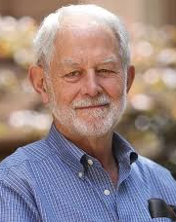
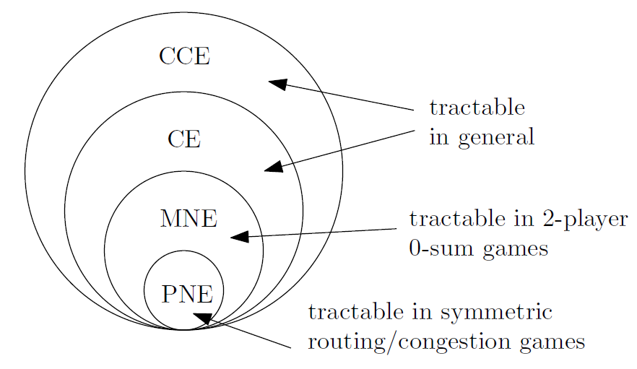
Why Is It Important?
Robert B. Wilson
2020 Nobel Prize
Mechanism design: auction have good properties
truthful bidding, social surplus maximization, ...
FNP problem: complexity theory

Slide 7
Quantum Game Theory
An academic perspective: generalization
The selfish genes
Quantum communication and quantum information
Better outcomes for games
Jens Eisert, Martin Wilkens, and Maciej Lewenstein, “Quantum Games and Quantum Strategies”

Slide 8
Quantum Gambling
Alice: box A (|a〉) and box B (|b〉)
Alice: prepare the particle in a state, send box B to Bob
Bob wins R coins
Bob: open box B, find the particle
Bob: not find the particle in B, ask Alice to send A, detect the state Alice prepared not the committed state |ψ_{c}〉
Alice wins 1 coin: other cases
Box: basis, Open: measure, R and |ψ_{c}〉: predeterminend
Pei Zhang, Xiao-Qi Zhou, Yun-Long Wang, Bi-Heng Liu, Pete Shadbolt, Yong-Sheng Zhang, Hong Gao, Fu-Li Li, Jeremy L. O’Brien, “Quantum gambling based on Nash-equilibrium”

Slide 9
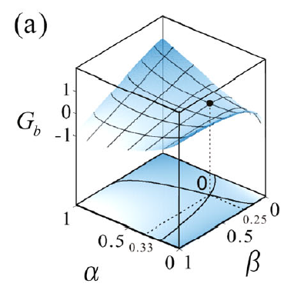
Quantum Gambling
Alice: prepare a state |ψ〉 = √(1-α) |a〉+ √α |b〉, 0≤ α≤1
Bob: change the state |b〉 to √(1-β) |b〉+ √β |b'〉, 0≤ β≤1
Opening-box stage vs verification stage
Players have incentives to be honest
Nash equilibrium exists
Pei Zhang, Xiao-Qi Zhou, Yun-Long Wang, Bi-Heng Liu, Pete Shadbolt, Yong-Sheng Zhang, Hong Gao, Fu-Li Li, Jeremy L. O’Brien, “Quantum gambling based on Nash-equilibrium”

Slide 10
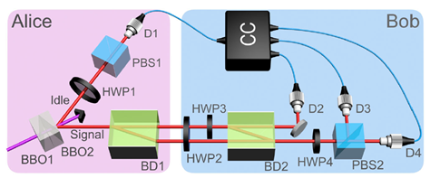
Quantum Gambling
proof-of-principle experimental demonstration
Pei Zhang, Xiao-Qi Zhou, Yun-Long Wang, Bi-Heng Liu, Pete Shadbolt, Yong-Sheng Zhang, Hong Gao, Fu-Li Li, Jeremy L. O’Brien, “Quantum gambling based on Nash-equilibrium”

Slide 11
Quantum Gambling
An interesting application
Touch on the idea of Nash equilibrium
Idea: Measurement leads to collapse
Pei Zhang, Xiao-Qi Zhou, Yun-Long Wang, Bi-Heng Liu, Pete Shadbolt, Yong-Sheng Zhang, Hong Gao, Fu-Li Li, Jeremy L. O’Brien, “Quantum gambling based on Nash-equilibrium”

Slide 12
Three Different Approaches
Game Types | Pros | Cons | Problem | Techniques
Classical Definition | Realistic | Restiricted | Interface | HHL algorithm Grover’s search
Classical Definition | Low-cost | Unfamiliar | Interface | Randomized algorithm
Quantum Definition | Free | Complex | Definition | Group theory

Slide 13

Classical Game
Find Mixed-Strategy Nash Equilibrium
Example: Matching pennies 錢幣配對
Equilibrium
solve system of linear equations !
Matching pennies |  | Player 2 |  | Player 1’s E [ payoff ]
 |  | Heads (p) | Tails (1-p)
Player 1 | Heads (q) | +1, -1 | -1, +1 | 1×p - 1×(1-p)
 | Tails (1-q) | -1, +1 | +1, -1 | -1×p + 1×(1-p)
Player 2’s E [ payoff ] |  | -1×q + 1×(1-q) | 1×q - 1×(1-q)

Slide 14
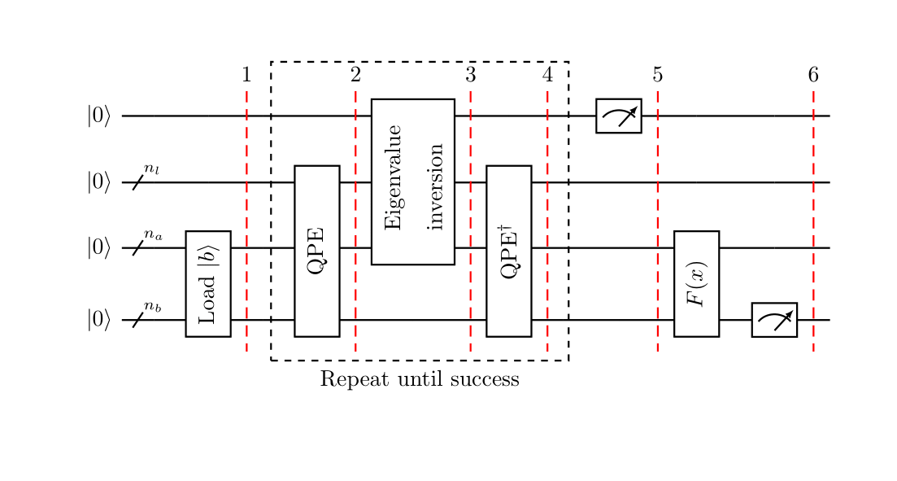
Classical Game
Solving system of linear equations
HHL quantum algorithm provides exponential speed-up over classical algorithm
https://qiskit.org/textbook/ch-applications/hhl_tutorial.html

Slide 15

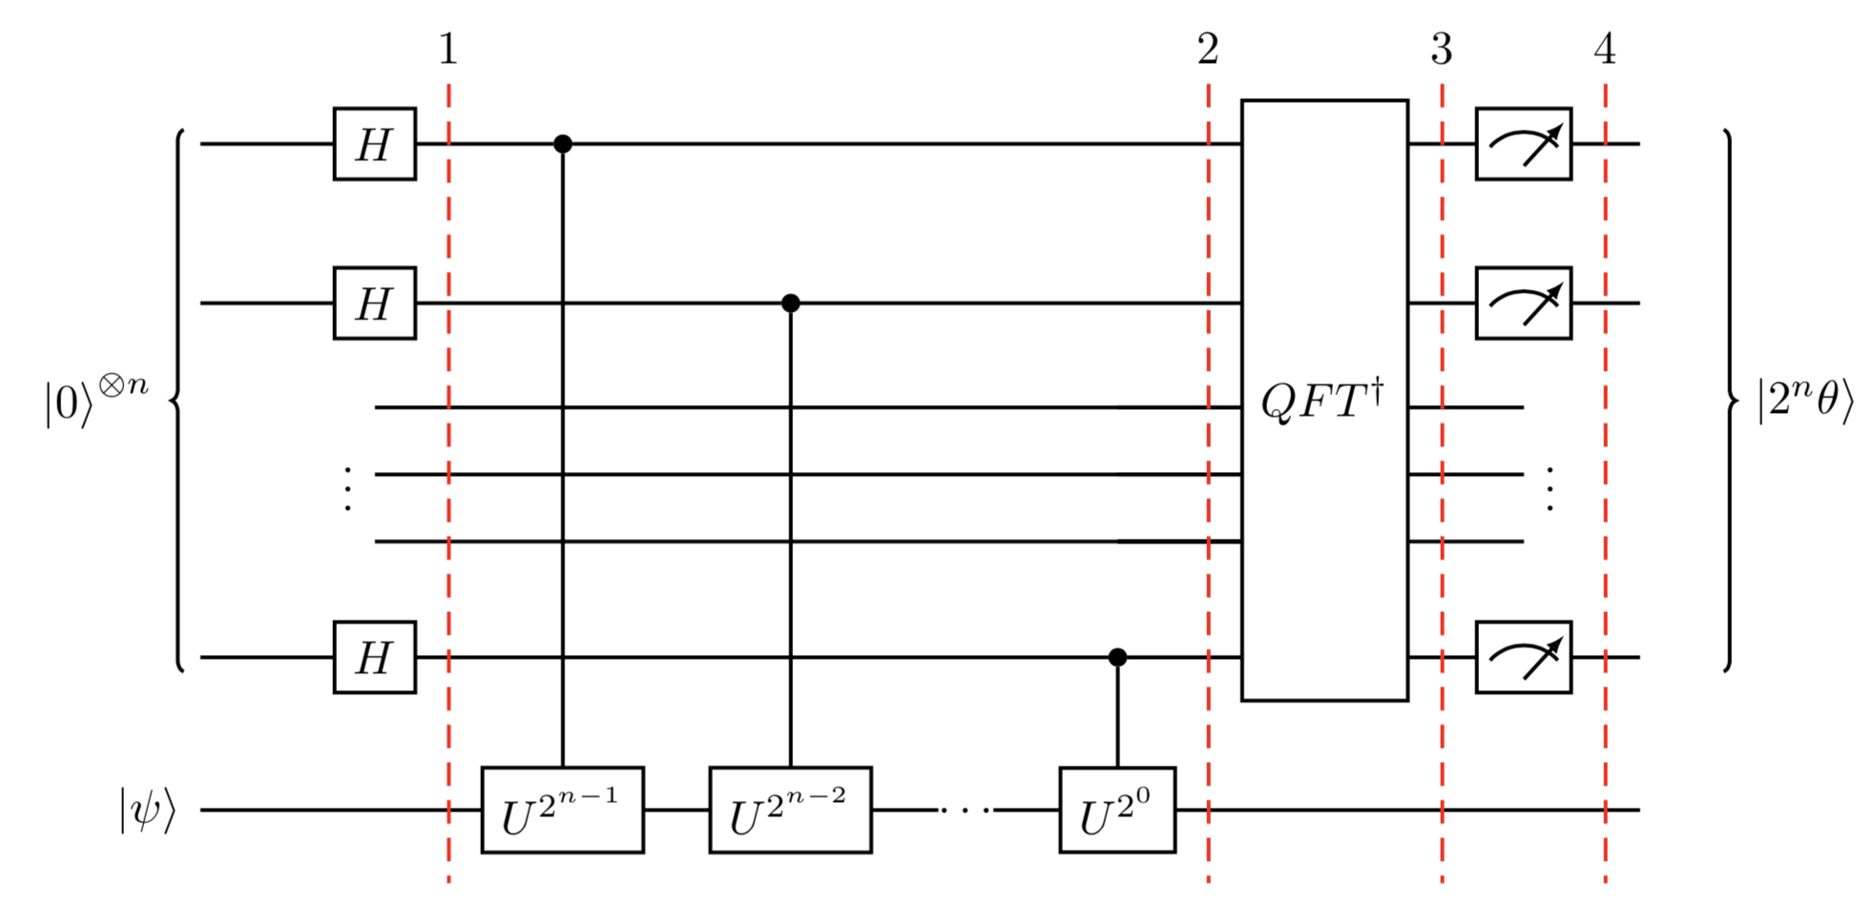
Classical Game
Solving system of linear equations by HHL
Background -- Quantum Phase Estimation (QPE)
For unitary operator U, the circuit estimates θ in
https://qiskit.org/textbook/ch-algorithms/quantum-phase-estimation.html

Slide 16
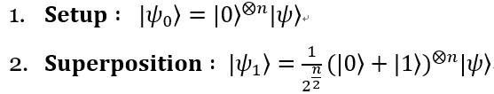
Classical Game
Solving system of linear equations by HHL
Background -- Quantum Phase Estimation (QPE) 1/3
https://qiskit.org/textbook/ch-algorithms/quantum-phase-estimation.html

Slide 17
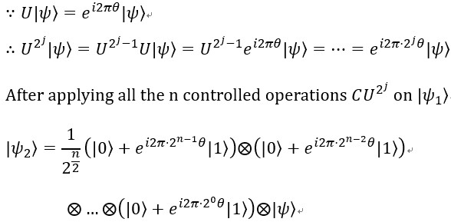
Classical Game
Solving system of linear equations by HHL
Background -- Quantum Phase Estimation (QPE) 2/3
https://qiskit.org/textbook/ch-algorithms/quantum-phase-estimation.html

Slide 18
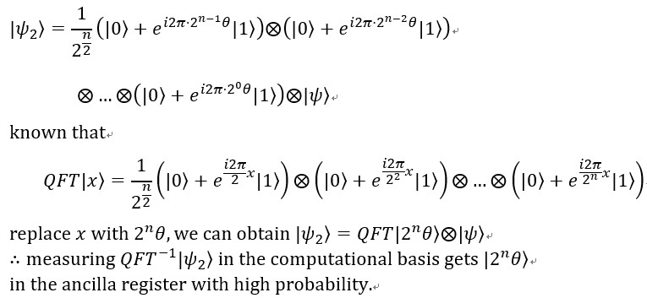
Classical Game
Solving system of linear equations by HHL
Background -- Quantum Phase Estimation (QPE) 3/3
https://qiskit.org/textbook/ch-algorithms/quantum-phase-estimation.html

Slide 19
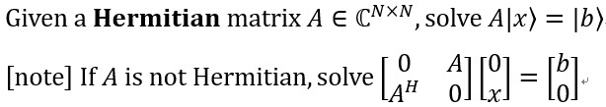
Classical Game
Solving system of linear equations by HHL
Problem description

Slide 20
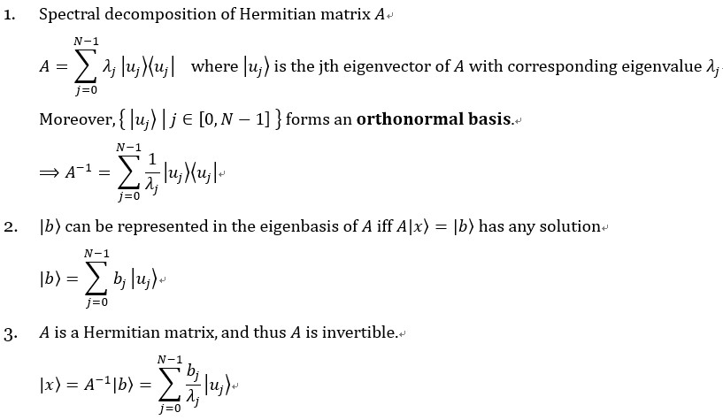
Classical Game
Solving system of linear equations by HHL
Other backgrounds

Slide 21
Classical Game
Solving system of linear equations by HHL
Other backgrounds

Slide 22
Classical Game
Solving system of linear equations by HHL
Procedure of HHL Algorithm
https://qiskit.org/textbook/ch-applications/hhl_tutorial.html

Slide 23
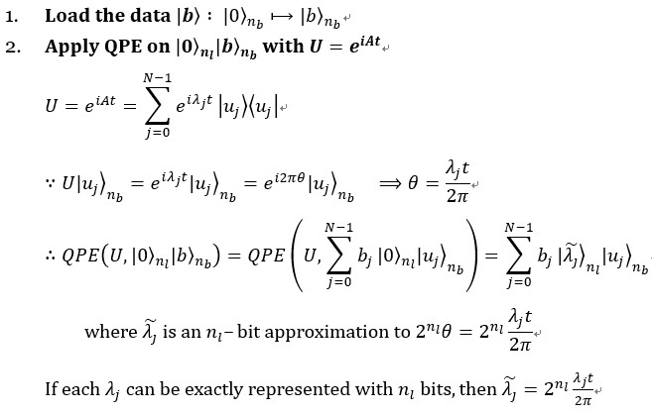
Classical Game
Solving system of linear equations by HHL
Procedure of HHL Algorithm
https://qiskit.org/textbook/ch-applications/hhl_tutorial.html

Slide 24
Classical Game
Solving system of linear equations by HHL
Procedure of HHL Algorithm
https://qiskit.org/textbook/ch-applications/hhl_tutorial.html

Slide 25
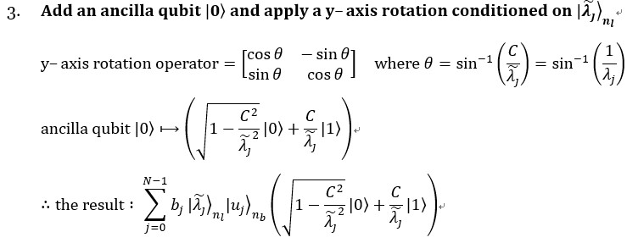
Classical Game
Solving system of linear equations by HHL
Procedure of HHL Algorithm
https://qiskit.org/textbook/ch-applications/hhl_tutorial.html

Slide 26
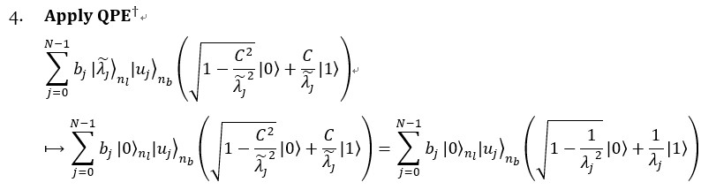
Classical Game
Solving system of linear equations by HHL
Procedure of HHL Algorithm
https://qiskit.org/textbook/ch-applications/hhl_tutorial.html

Slide 27
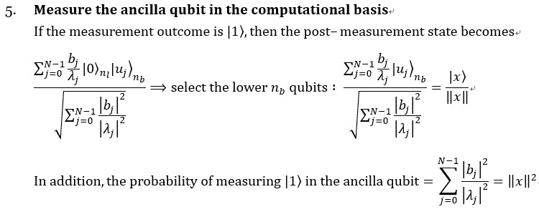
Classical Game
Solving system of linear equations by HHL
Procedure of HHL Algorithm
https://qiskit.org/textbook/ch-applications/hhl_tutorial.html

Slide 28
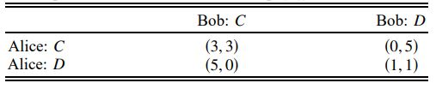
Quantum Game
Prisoner’s Dilemma
Jens Eisert, Martin Wilkens, and Maciej Lewenstein, “Quantum Games and Quantum Strategies”

Slide 29

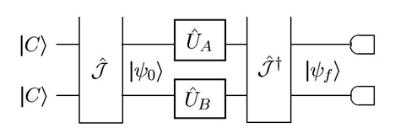

Quantum Game
Circuit (for 2- player symmetric game)
Jens Eisert, Martin Wilkens, and Maciej Lewenstein, “Quantum Games and Quantum Strategies”

Slide 30


Quantum Game
Differences?
1.J Operator > entangle game
2.U Operator
Pei Zhang, Xiao-Qi Zhou, Yun-Long Wang, Bi-Heng Liu, Pete Shadbolt, Yong-Sheng Zhang, Hong Gao, Fu-Li Li, Jeremy L. O’Brien, “Quantum gambling based on Nash-equilibrium”

Slide 31
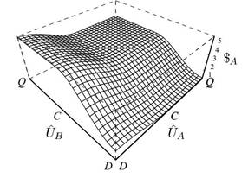
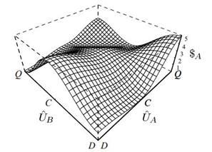
Quantum Game
Prisoner’s Dilemma
γ =0 NE=(D,D) payoff:(1,1) γ = pi/2 NE=(Q,Q) payoff:(3,3)
Jens Eisert, Martin Wilkens, and Maciej Lewenstein, “Quantum Games and Quantum Strategies”

Slide 32
Quantum Game
Prisoner’s Dilemma
unfair game?
player 1: quantum strategy
player 2: classical strategy
γ=π/2 (maximum entanglement)
Jens Eisert, Martin Wilkens, and Maciej Lewenstein, “Quantum Games and Quantum Strategies”

Slide 33
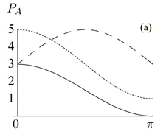
Quantum Game
Prisoner’s Dilemma
consider maxmin value:
player1: M= U(π/2,π/2)
for classical strategy
=> maxmin no higher than 1 (D strategy)
Jens Eisert, Martin Wilkens, and Maciej Lewenstein, “Quantum Games and Quantum Strategies”

Slide 34
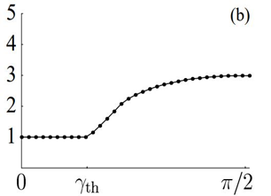
Quantum Game
Prisoner Dilemma
When to defect from taking
D strategy?
γ=arcsin((⅕)^{0.5} )
Jens Eisert, Martin Wilkens, and Maciej Lewenstein, “Quantum Games and Quantum Strategies”

Slide 35
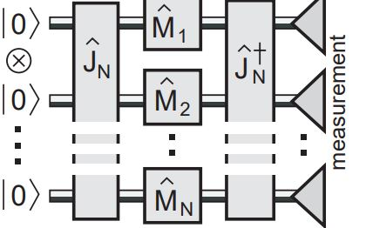

Quantum Game
Extension:
1. N players:
“pure strategy” exists
>> reduce time complexity
Simon C. Benjamin and Patrick M. Hayden, “Multi-Player Quantum Games”

Slide 36
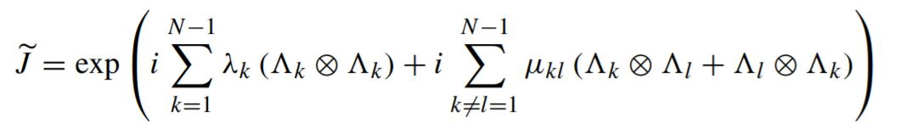
Quantum Game
Extension:
2. N strategies:
multiparameter : proportional to N²
maximal entanglement is a large group
Bolonek -Lason´, “General quantum two-player games, their gate operators, and Nash equilibria Katarzyna”

Slide 37
Future
Convergence of game theory and quantum mechanics
New solutions lead to new problems
High complexities not resolved
Error

Slide 38
Thank You!

Slide 39
References
1.R. B. Myerson, Game Theory: An Analysis of Conflict
2.Jens Eisert, Martin Wilkens, and Maciej Lewenstein, “Quantum Games and Quantum Strategies”
3.https://mindyourdecisions.com/blog/2013/06/11/game-theory-in-bobs-burgers-spoilers/
4.Pei Zhang, Xiao-Qi Zhou, Yun-Long Wang, Bi-Heng Liu, Pete Shadbolt, Yong-Sheng Zhang, Hong Gao, Fu-Li Li, Jeremy L. O’Brien, “Quantum gambling based on Nash-equilibrium”
5.https://qiskit.org/textbook/ch-applications/hhl_tutorial.html
6.https://qiskit.org/textbook/ch-algorithms/quantum-phase-estimation.html
7.Matthew O. Jackson, “A Brief Introduction to the Basics of Game Theory”
8.Aram W. Harrow, Avinatan Hassidim, and Seth Lloyd, “Quantum algorithm for linear systems of equations”
9.http://www.cmlab.csie.ntu.edu.tw/~wcchen/QAnotes/HHL%2014.pdf
10. Simon C. Benjamin and Patrick M. Hayden, “Multi-Player Quantum Games”
11.Bolonek -Lason´, “General quantum two-player games, their gate operators, and Nash equilibria Katarzyna”

Slide 40
Pictures
1..https://www.thestreet.com/personal-finance/education/what-is-game-theory-14761288
3.https://zh.wikipedia.org/wiki/%E7%BD%97%E6%9D%B0%C2%B7%E6%A2%85%E5%B0%94%E6%A3%AE
4.https://www.nobelprize.org/prizes/economic-sciences/1994/nash/facts/
6.https://read01.com/BJaQBdK.html#.X_PZCtgzY2w

